Slide 1
Automating scRNA-seq Workflows
Dev Nambi, 2019-04-15

Slide 2
Business Problem, Concept, & History
Problem
scRNA-seq processing is manually done by researchers across multiple teams, with no standard process.
All communication, coordination, code, and troubleshooting is custom.
This is expensive and doesn’t scale
Concept & History
The raw infrastructure (e.g., Gizmo; Slurm) exists to do this work, but higher-level workflow tools and data management patterns aren’t in wide use
Scicomp has built out Cromwell for cloud workflows, and is working on extending it
Researchers write their own scripts and manual pipelines

Slide 3
Proposed Solution
The proposed solution is 3 parts:
Workflow system that can talk to Slurm
Options include Cromwell, Nextflow, Snakemake
Coordinate with other teams exploring workflow systems at the Hutch.
Common Pipelines
Help RG’s lab turn their raw scripts into pipelines that can be standardized+extended. Pipelines are run on the workflow system. Teach RG’s lab to make their own.
Standardized Input (API) Coordinate between RG’s lab & their partner labs to come up with standardized ways to request scRNA-seq processing. (first a file format, then an API or command-line tool).
(Stretch Goal) - Extend this past scRNA-seq to other workflows (e.g. ChIP-seq)

Slide 4
Support for the FHCRC and HDC Strategic Plans
Aligns with the Center’s goal of developing critical infrastructure
Aligns with HDC’s goals of fostering data-centered collaborations and expanding analytic capabilities.

Slide 5
Customer Commitment
How committed is the customer?
The Gottardo lab (RobA) is extremely interested, because even incremental improvements would reduce their workload and allow them to do more research. Rob A (RG lab postdoc) has been a great collaborator, helping to define requirements, provide design feedback, and offering assistance.
Does the work align with the customers FHCRC strategic goals?
Yes, in several ways. It gives us insight into the patterns and practices of multiple labs. It helps define workflow and data management approaches that would gain wide adoption. The request forms and output could be made discoverable via Cortex.

Slide 6
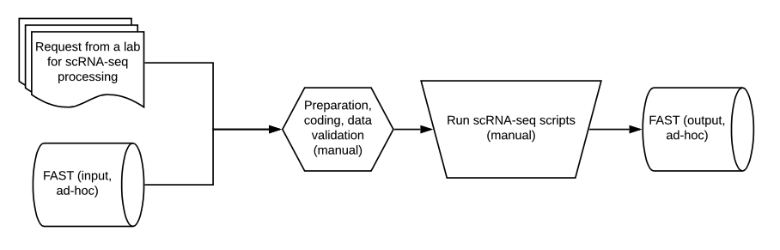
Current Design
What data types are involved?
scRNA-seq files (e.g., FASTQ)
Metadata (e.g., JSON; CSV)

Slide 7
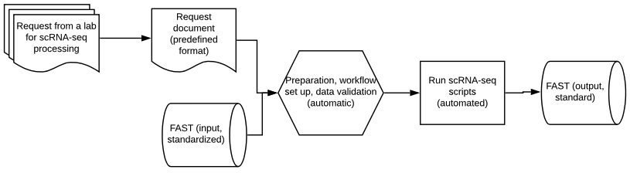
Proposed Design
What data types are involved?
scRNA-seq files (e.g., FASTQ)
Metadata (e.g., JSON; CSV)
Notes:
Metrics - time saved. Time to return. Set a baseline.

Slide 8
Scope
Scope – Coordinate & implement workflow system. Convert scRNA-seq to workflows and train RG lab in their development. Coordinate cross-team inputs to be structured. Automate as much of the entire process as possible.
Success Criteria – RG lab is running repeatable, programmatic workflows end-to-end, and can extend/maintain them themselves. Standard format adopted for input data & requests. Human time required to run each workflow reduced by 80%+
Timeline: 7 weeks, 1 data engineer working 50%
3 weeks – Workflow system. Evaluate, decide, adopt. Coordinate with Scicomp engineers
2 weeks – Common pipelines. Convert existing ones, try new ones, train RG lab
2 weeks – Standardize input. Coordinate across multiple labs. Create docs, examples, drive adoption.
Notes:
Adopt best practices. Scratch file system.

Slide 9
Internal & External Costs
Team Costs
Role/skills | Duration of work required | Estimated cost $2600/week/person
Data Engineer | 0.5FTE for 7 weeks (Q1FY19) | $9,100
Systems Engineer | 0.5FTE for 1 week (Q1FY19) * Coordination+review of workflow tools | $1,300
Total Team Cost (estimated) |  | $10,400

Slide 10
Return on Investment (immediate)
What would the impact be to you (RobA) and your team (Gottardo lab) if a system existed that let you run workflows with no/minimal setup?
“Impact would be that it helps us standardize our workflows across one another, thus making our data more readily comparable to one another. This would foster both improved and more collaboration between not only members within our group, but also across the center. The importance of scRNA-seq and its outsize role in exploratory, discovery-driven experiments can't be understated, and so such tooling would allow us to work more efficiently and collaboratively.”
“Furthermore, our bioinformatics group is working on developing new methods for scRNA-seq, and to do this we rely on processing raw data derived from other labs outside the center so that we can harmonize the end results for comparative analyses. Currently, we each have our own versions of the scRNA-seq processing workflow, and furthermore, our own scripts are not as efficient as they could be in parallelizing key steps. Hiccups in the workflow running are not uncommon, and can take large amounts of time to troubleshoot and rerun. Having a standardized workflow that automates and manages these aspects - especially as we continue to add new data - would help us to further focus on performing research-critical tasks that better suit our expertise.”

Slide 11
Return on Investment (longer-term)
Who else at FH would benefit from this?
“Fred Hutch is investing significantly in scRNA-seq experimental setups, and is internally funding many scRNA-seq driven experimental designs. Given this focus, our group and others at the Hutch would benefit from such standardized workflows that help us better collaborate and get analytical results in a time-efficient manner.”
What would the benefit be if we did this for other processes?
“For other processes/workflows, the benefits again would fall under standardization of results that allows for better cross-comparisons, as well as having a well-annotated pipeline for processing that can be referenced as needed. However, I strongly believe that focusing on scRNA-seq first is of utmost importance because of the center's mission-critical work in discovery-based analyses that right now is being driven by scRNA-seq studies.”

Slide 14
Appendix

